Slide 1



TOPIC:-
CARBON EMISSION PREDICTION[C02]
STUDENT NAME:-
MADASI KURUVA DAMODAR
AICTE STUDENT ID:-INTERNSHIP_1746416864681834e0e35d8

Slide 2

Learning Objectives
Understanding the Real-World Problem
Transformed Raw Data into Meaningful Insights
Discovered the Power of Feature Selection
Model Evaluation and Tuning
Data Handling and Preprocessing
Used regression models like Random Forest to predict CO₂ emission levels accurately
Machine Learning Basics
Gained Confidence in Industry Tools & Workflows
Bridged the Gap Between Code and Communication
Predicted Carbon Emissions Using AI-Driven Models
GOAL
Source :
www.freepik.com/

Slide 3
Tools and Technology used
1.Programming language
python
2.Machine Learning Libraries
scikit-learn – for training models like Linear Regression, Random Forest, and feature selection
NumPy – for numerical operations and array manipulation
Pandas – for data loading, cleaning, and analysis
3.Data Handling & Visualization
Matplotlib/seaborn – for visualizing data distributions, trends, and correlations
4.Development Environment
Google Colab(3.10) – cloud-based Python coding and model building
Jupyter Notebook – interactive coding and results visualization
5. Version Control & Collaboration
GitHub – for storing datasets, notebooks, and sharing code
6. Data Format
CSV (Comma-Separated Values) – for storing and handling real-world structured data

Slide 4
Methodology
Problem Understanding Understood the objective: to predict carbon emissions using real-world data and AI.
Data Collection & Preprocessing Used a CSV dataset, cleaned missing values, and selected relevant features.
Feature Selection Applied RFECV to choose the most important features for prediction.
Model Building Trained machine learning models like Random Forest and Linear Regression.
Model Tuning & Validation Used GridSearchCV and cross-validation to improve model performance.
Prediction & Evaluation Predicted emissions and evaluated the model using R² Score, MSE, and RMSE.

Slide 5
Problem Statement:
Carbon emissions are silently shaping the future of our cities. With rapid urbanization and industrial growth, we lack precise tools to predict how our daily actions contribute to climate change. Without data-backed predictions, policies become reactive instead of proactive
Carbon emissions are one of the leading causes of climate change, impacting air quality, weather patterns, and public health globally.
However, most developing regions lack reliable tools to predict future emissions trends based on economic and environmental indicators.
Without accurate forecasts, policymakers and urban planners cannot take timely actions to reduce emissions or promote sustainable development.

Slide 6
Solution:
I built a machine learning model that forecasts per capita carbon emissions using real-world socio-economic and environmental data. This model empowers policymakers to visualize the future impact of today’s development choices — enabling smarter, greener cities
Not just predicting numbers — predicting impact
GIT-LINK:-
WEEK-1:-https://github.com/MADASIKURUVADAMODAR/WEEK-1.git
WEEK-2:-https://github.com/MADASIKURUVADAMODAR/week-2.git
WEEK-3:-

Slide 7
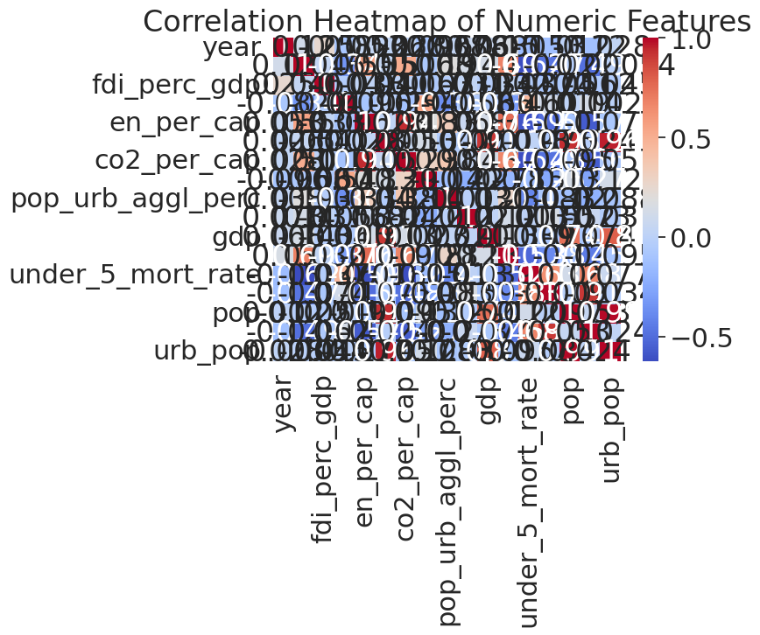
Screenshot of Output:
1.Exploratory Data Analysis (EDA)
Correlation heatmap showing relationships between features such as energy usage, GNI, urbanization, and carbon emissions

Slide 8
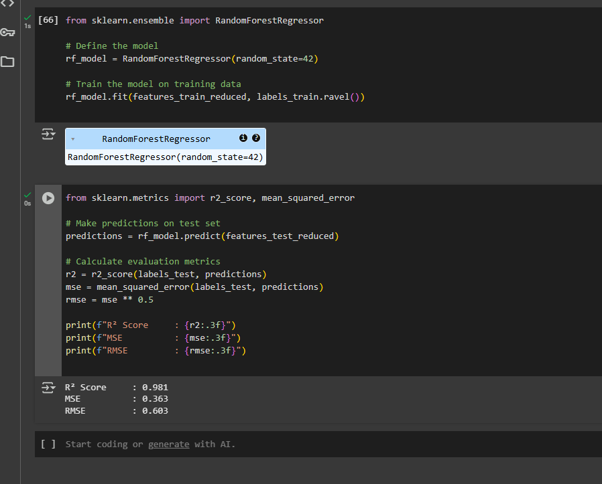
Screenshot of Output:
Model Building and model evaluation
Trained Random Forest model on selected features after preprocessing and feature reduction

Slide 9
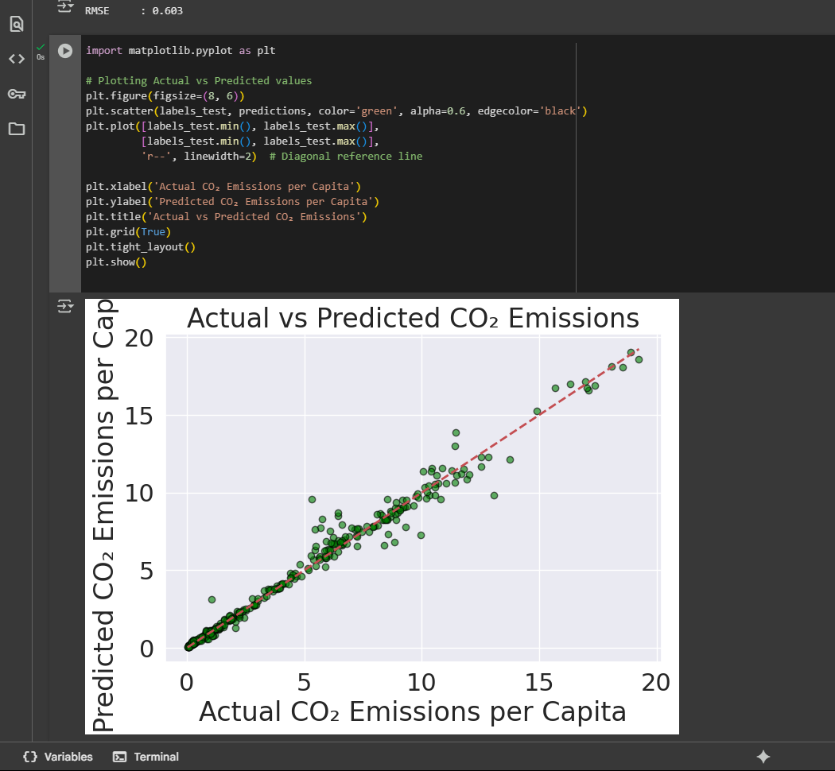
Screenshot of Output:
Predicted vs Actual CO₂ Emissions
The scatter plot illustrates that predicted CO₂ emissions align closely with actual values. This indicates strong model accuracy and reliabilityPredicted vs Actual CO₂ Emissions

Slide 10
Conclusion:
In this project, I successfully predicted per capita carbon emissions using real-world data and a machine learning model.
The Random Forest Regressor delivered high accuracy (R² = 0.981), proving effective at capturing complex relationships between features like energy usage, urban growth, and economic indicators.
This predictive model can help governments, urban planners, and environmental agencies make better decisions in reducing carbon emissions and planning sustainable development.
With further optimization and access to real-time data, this model could scale to help monitor carbon footprints at city or national levels, supporting climate goals.

Slide 11
Future scope:-
1)Incorporate real-time satellite and sensor data to enhance model accuracy.
2)Extend predictions to region-wise or city-level emissions.
3)Integrate the model into a climate monitoring dashboard for government or research use.
4)Experiment with other ML models like Gradient Boosting, XGBoost for performance comparison.
5)Add more variables (e.g., industrial output, vehicle density, forest loss) for deeper insights.

